Slide 1
High-Voltage Insulation and Transmission Technology
High-Voltage Engineering

Slide 2
Introduction
CU High Voltage (HV) Laboratory was established in 1955 as the 1st one in Thailand. Since then the laboratory has been active in education, research, and services.
Various Equipment have been successfully built by our laboratory include high voltage kits, impulse generators, and SF6 transformers.

Slide 3
Vision
High-Voltage technology program focuses on
Design, construction and diagnostic of HV equipment.
HV-related phenomena and their industry applications
Particular interests are on the problems in local industries and Thailand’s research agenda.
Students from other institutions are also welcome to utilize our facilities for their study/research so as to maximize the resource usage.

Slide 4
Roles with Industrial Sections
The HV Laboratory has been assigned responsibility by the Thai Government for electrical product tests in compliance with Thai Industrial Standards and with other standards such as IEC, ANSI, AS, etc.
The test facilities are used to analyze problems of insulation in power systems and the characteristics and performances of the high voltage equipment. Problem-based services are carried out according to requests from industry.

Slide 5
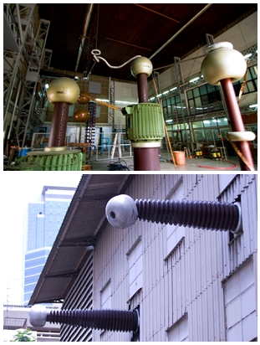
Strength of High-Voltage Laboratory
Best HV facilities among universities in Thailand
International collaboration for in-depth research
Cooperation with agencies such as electric utilities and manufacturers for practical knowledge

Slide 6
Graduate Study Programs
New master and doctoral programs provide two tracks for graduate students:
High-Voltage Insulation and Transmission Technology (HVITT):
Focus on the HV equipment usages and the linkage to industries in various aspects.
High-Voltage Engineering (HVE):
Aim to provide the study in the HV field in depth and more specific fields of research.

Slide 7
Recommend Course Structure: HVITT
Group | Credit | Course name
Selective Compulsory | 6 | Take 2 from the following 7 courses: Finite Element Analysis for Electrical Engineers Fundamentals of Electromagnetic Compatibility Advanced High-Voltage Engineering Applications High-Voltage Equipment Maintenance and Testing Substation Automation Systems Electrical Transients in Power Systems Electric Field Analysis in High Voltage Engineering
Elective | 12 | Select courses from department list for 12 credits
Industrial Experiences/Internship Aboard | 6 | 3 Options for students (a) Industrial Experiences I + II + III (b) Internship Aboard I + II + III (c) Select courses from department list for 6 credits
Thesis | 12 | Thesis
Additional | 2, S/U | Research Methodology

Slide 8
Recommend Course Structure: HVE
Group | Credit | Course name
Selective Compulsory | 6 | Take 2 from the following 7 courses: Finite Element Analysis for Electrical Engineers Fundamentals of Electromagnetic Compatibility Advanced High-Voltage Engineering Applications High-Voltage Equipment Maintenance and Testing Substation Automation Systems Electrical Transients in Power Systems Electric Field Analysis in High Voltage Engineering
Elective | 6 | Select courses from department list for 6 credits
Thesis | 24 | Thesis
Additional | 2, S/U | Research Methodology

Slide 9
Current Research/Study
Impact of striking distance on shielding failure : Effect of OHG distance
8 m distance
Tower height [m]
OHG+TOP+MID
OHG+TOP
OHG
I (kA)
10 m distance
At 7.5 kA, no strike at TOP
Tower height [m]
OHG+TOP
OHG
I (kA)

Slide 10
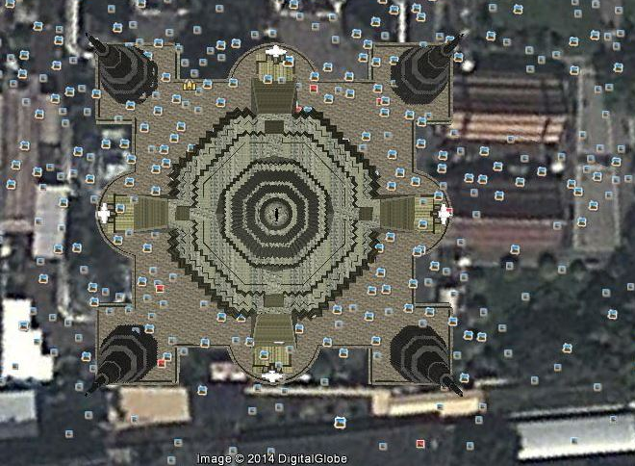
Current Research/Study
Risk assessment of Wat Arun pagoda : Question to IEC62305 Ed.2
Risk R1 (danger to life) ≠ 0, why?
N

Slide 11
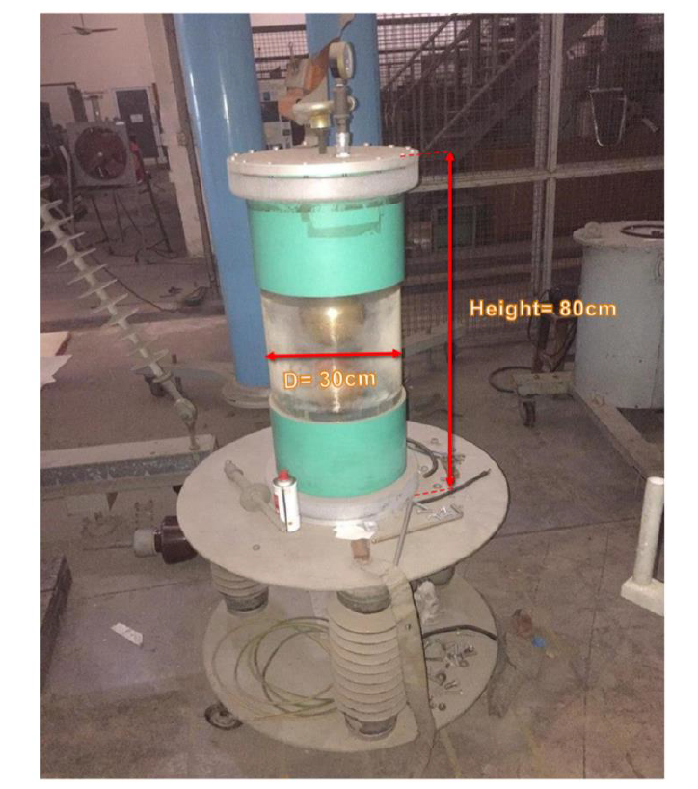
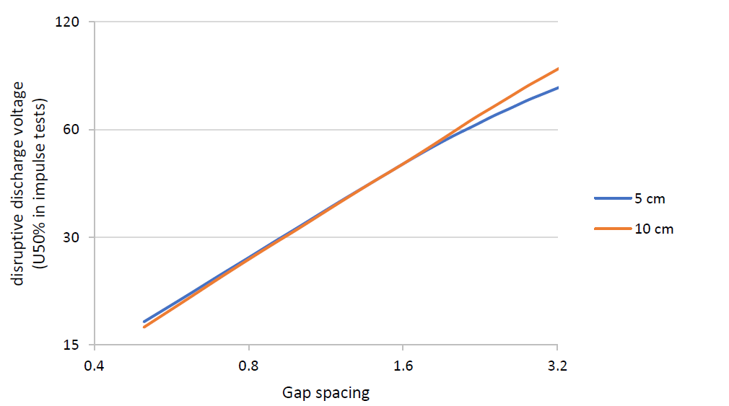
Current Research/Study
Effect of UV irradiation on U_{b} of small sphere gaps: Revisit of the IEC60052
U_{b} of 5 cm > 10 cm sphere, for g < 1.2 cm, why?

Slide 12

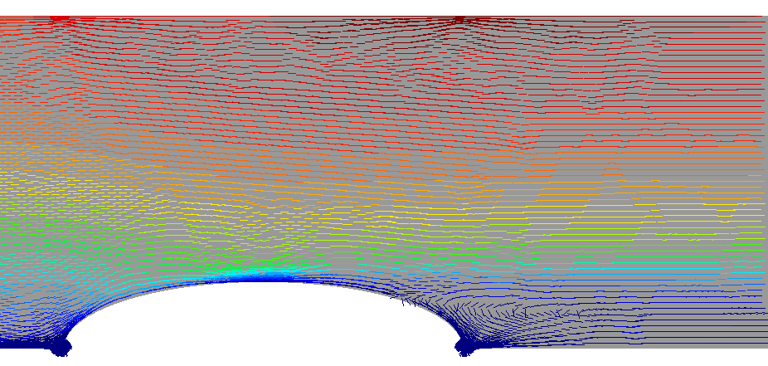
Current Research/Study
Applications of Pulsed Electric Fields: Temperature Rise and Microbial-Inactivation Efficiency
PEF is a non-thermal method for treating liquid foods by using electrical pulses to inactivate microbial in foods. Numerical study has been carried out to study multiple physics related to the PEF treatment such as power consumption, temperature rise and microbial inactivation efficiency.
Upper:
Electric field distribution
Between electrodes shown
In color scales
Lower:
Streamlines of the liquid flow

Slide 13
Current Research/Study
Particle Electromechanics: Dynamic behavior
Particles are involved in a variety of applications such as electrostatic precipitator, painting, and coating. The motion of particles are controlled by their charges and the interaction with electric field. The effects of various parameters have been studied both by analytical and by experimental approaches.
Left: Pressurized vessel for experiments. Right: Simulation of electric field on
particle surface.

Slide 14
Faculties

Slide 15
Faculties

