Slide 1
Power & Energy
PEn @ CUEE

Slide 2
Group Research of Cluster
Bio-electronics
Power and Energy
Data Analytics
Control and Embedded Systems
Advanced Materials and Devices
Telecom, Networking and Systems

Slide 3
Curriculum
M. Eng Curriculum
Professional-Based Study Programs | Research-Based Study Programs
24 + 12 (Credits: Coursework + Thesis) | 12 + 24 (Credits: Coursework + Thesis)

Slide 4
Study Programs
Professional-Based Study Programs |  |  | Research-Based Study Programs
Smart Grids and Renewable Energy Technology | Power Electronics Applications | High-Voltage Insulation and Transmission Technology | Power and Energy Systems | High-Voltage Engineering | Power Electronics

Slide 5
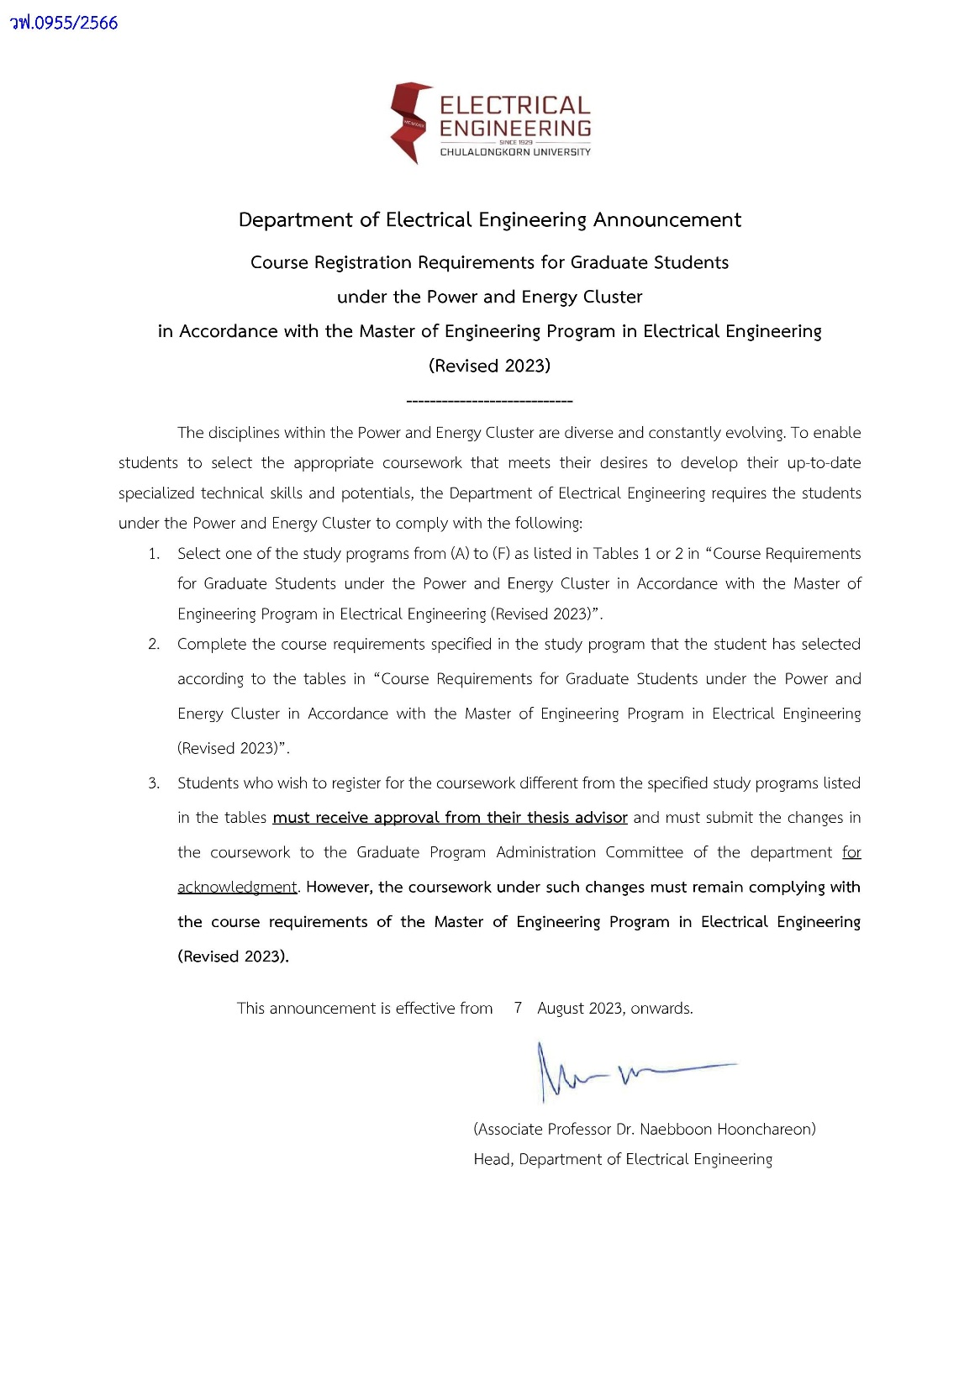

Slide 7
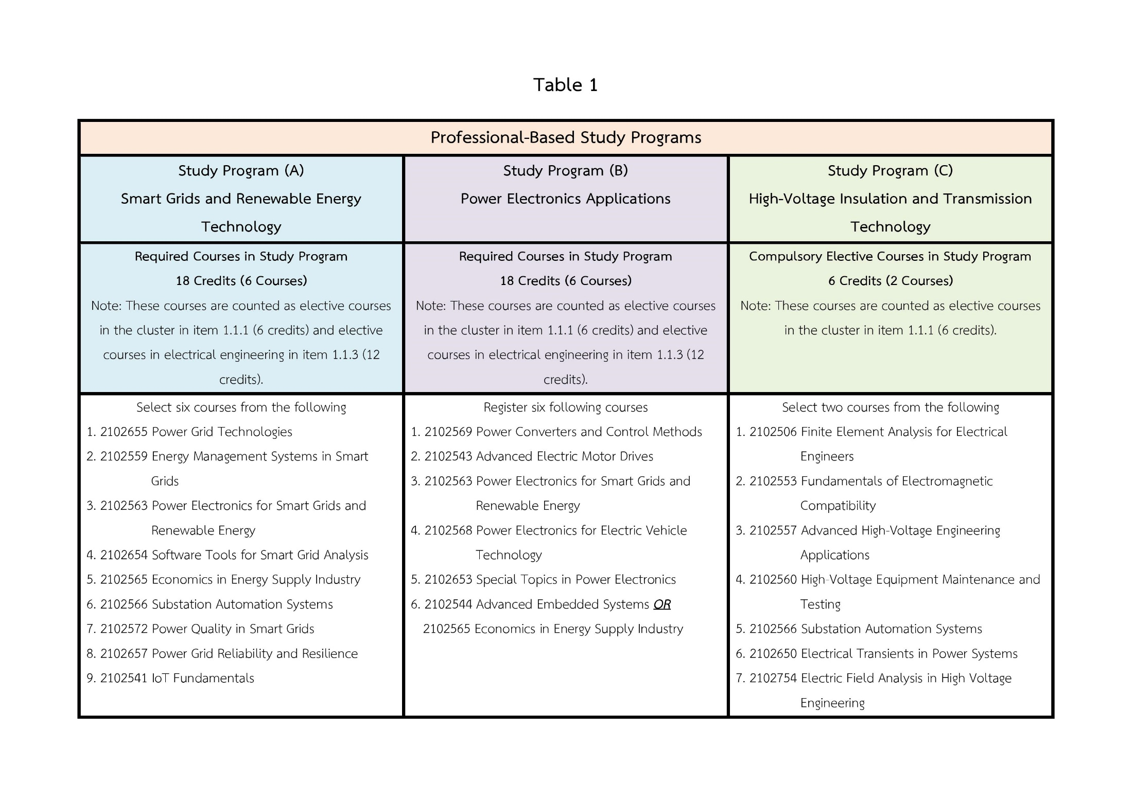

Slide 8
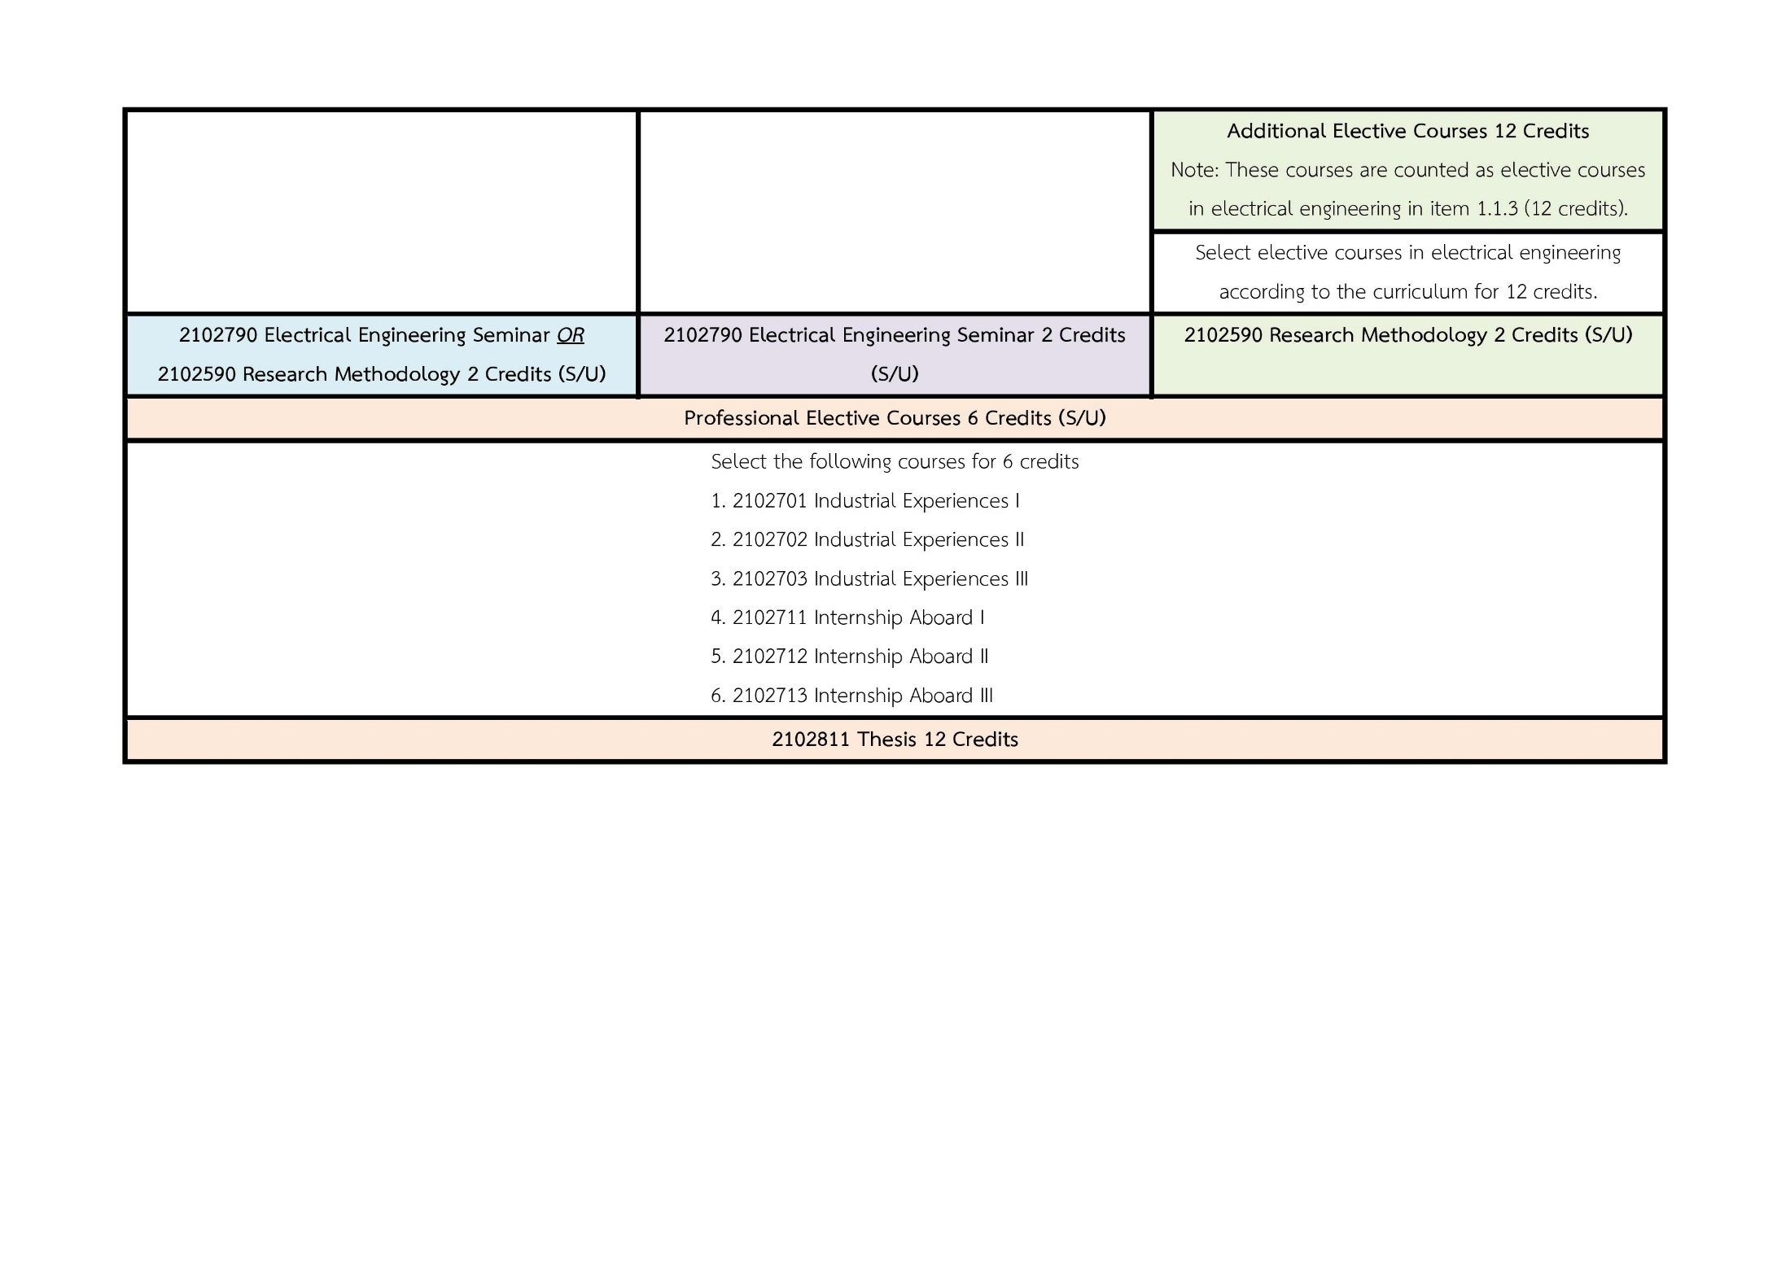

Slide 9
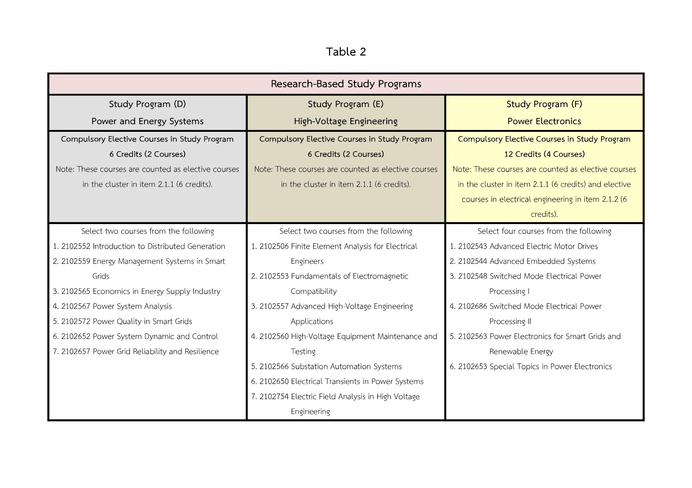

Slide 11
Courses
Course Number | Course Name | Semester
2102506 | Finite Element Analysis for Electrical Engineers | 2
2102541 | IoT Fundamentals | 2
2102543 | Advanced Electric Motor Drives | 2
2102544 | Advanced Embedded Systems | 1
2102548 | Switched-Mode Electrical Power Processing I | 1
2102552 | Introduction to Distributed Generation | 2
2102553 | Fundamentals of Electromagnetic Compatibility | 2
2102557 | Advanced High-Voltage Engineering Applications | 2
2102559 | Energy Management Systems in Smart Grids | 1

Slide 12
Courses
Course Number | Course Name | Semester
2102560 | High Voltage Equipment Maintenance and Testing | 1
2102563 | Power Electronics for Smart Grids and Renewable Energy | 1
2102565 | Economics in Energy Supply Industry | 2
2102566 | Substation Automation Systems | 2
2102567 | Power System Analysis | 1
2102568 | Power Electronics for Electric Vehicles Technology | 2
2102569 | Power Converters and Control Methods | 1
2102572 | Power Quality in Smart Grids | 2

Slide 13
Courses
Course Number | Course Name | Semester
2102650 | Electrical Transients in Power Systems | 1
2102652 | Power System Dynamic and Control | 2
2102653 | Special Topics in Power Electronics | 1
2102654 | Software Tools for Smart Grid Analysis | 2
2102655 | Power Grid Technologies | 1
2102657 | Power Grid Reliability and Resilience | 1
2102686 | Switched-Mode Electrical Power Processing II | 2
2102754 | Electric Field Analysis in High Voltage Engineering | 1

Slide 14
Map
Power and Energy Systems
Power Electronics
High Voltage

Slide 15
Information
Website : www.ee.eng.chula.ac.th
Facebook : www.facebook.com/EE.chula
Alternate site : www.facebook.com/CUEEPSA www.facebook.com/EGSACU

