Slide 1
iSystems & IC Design Cluster @EECU
1 February 2025
Motivations, Vision, Mission, Research Fields & Course Guidelines

Slide 2

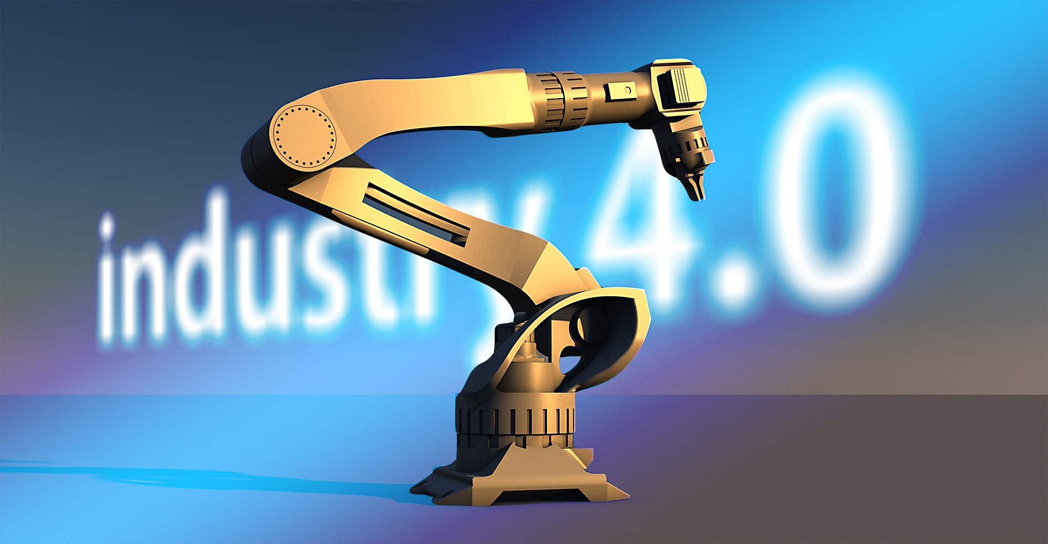

Thailand 4.0
People 4.0
Government 4.0
Education 4.0
Finance 4.0
Energy 4.0
Industry 4.0
Factory 4.0
Farming 4.0
Healthcare 4.0

Slide 3
Motivations
More & more embedded systems & IoT networks, e.g. smart appliances, health monitoring devices (Smart Things)
More & more self-decision machines, e.g. autonomous vehicles, companion robots (Smart Decisions)
More & more IC are required due to more smart devices
Support smart life/smart community/smart grids & Aging society

Slide 4
Vision
Trains our students to be future leaders in
todays fast-changing intelligent world.

Slide 5
Mission
Lets students be experts in new technologies such as AI, IC Design, Embedded Systems and IoT.
Practices student to have experience in self-control/self-decision devices & systems such as wearable devices, network sensors, autonomous vehicles, smart robots, smart factory, smart farms, and smart grid.
Trains students to be lifelong self-learners.

Slide 6
Compulsory Elective Courses
Students must pass at least two of these courses.
2102541 IoT Fundamentals (พื้นฐานอินเทอร์เน็ตของสรรพสิ่ง)
2102544 Advance Embedded Systems (ระบบฝังตัวขั้นสูง)
2102635 Control System Theory (ทฤษฎีระบบควบคุม)
2103530 Industrial Robots I (หุ่นยนต์อุตสาหกรรม 1)
2103535 Mechatronics (แมคคาทรอนิกส์)
2103630 Industrial Robots II (หุ่นยนต์อุตสาหกรรม 2)
2110654 Artificial Intelligence (ปัญญาประดิษฐ์)
2110743 Machine Learning (การเรียนรู้ของเครื่อง)
2110746 Big Data Analytics (การวิเคราะห์ข้อมูลใหญ่)

Slide 7
Examples of Two Elective Compulsory Courses
Smart Things 2102541 IoT Fundamentals 2102544 Advanced Embedded System | Smart Thinks 2102541 IoT Fundamentals 2110654 Artificial Intelligence
Smart Robots 2102541 IoT Fundamentals 2103535 Mechatronics | Factory 4.0 2102544 Advanced Embedded System 2103530 Industrial Robots
Smart Control 2102541 IoT Fundamentals 2102635 Control System Theory | Smart Decision 2102635 Control System Theory 2110743 Machine Learning
IC Design 2102545 Digital IC Design 2102546 Analog IC Design | Systems & Control 2102505 Intro to Optimization 2102635 Control System Theory

Slide 8
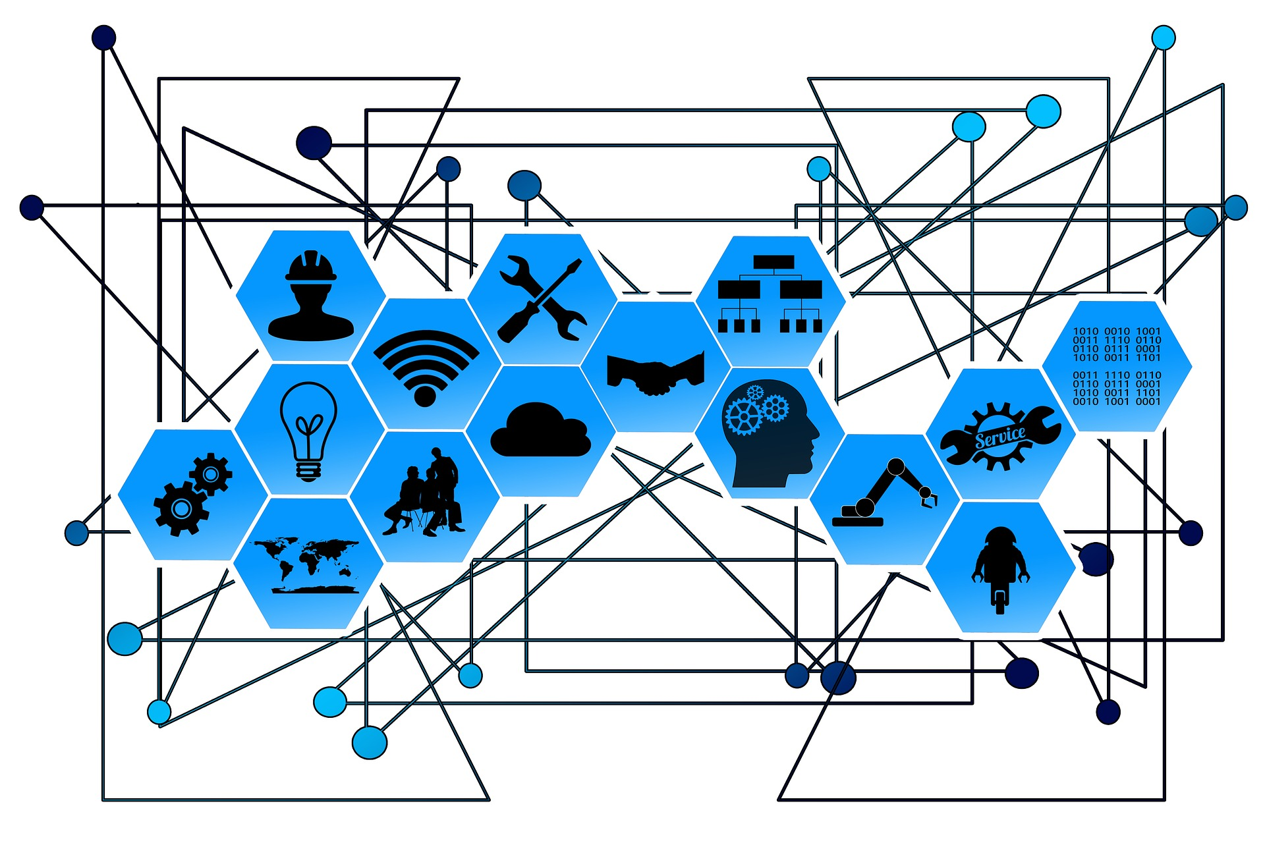
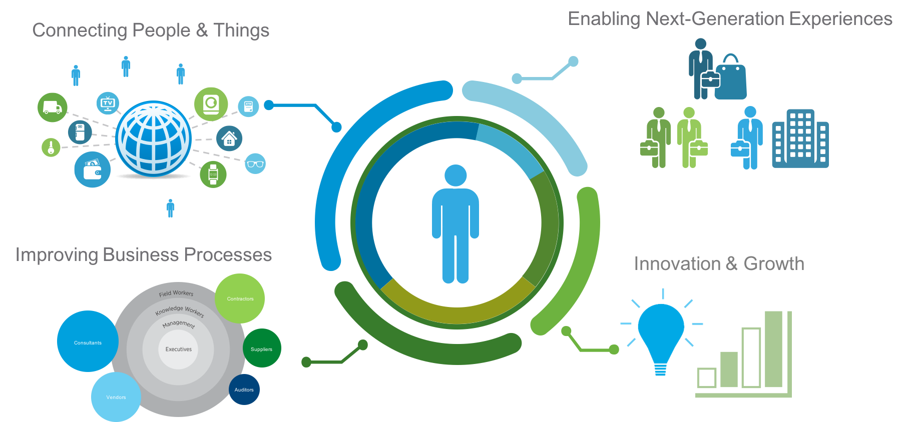
IoT & Big Data

Slide 9
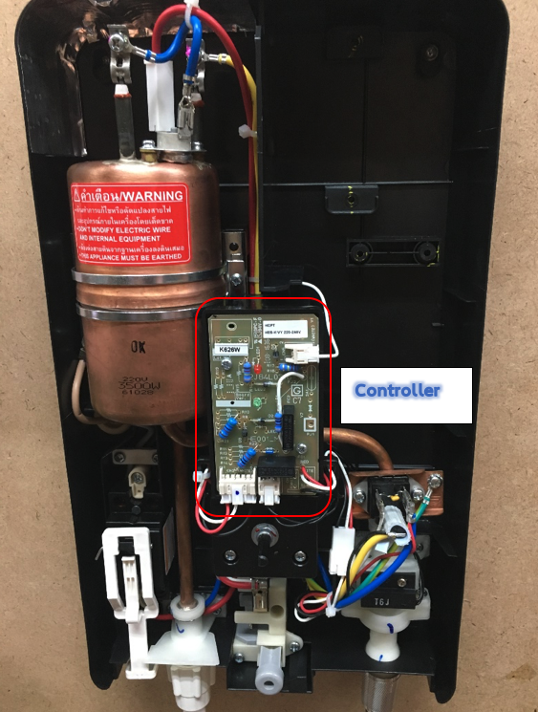
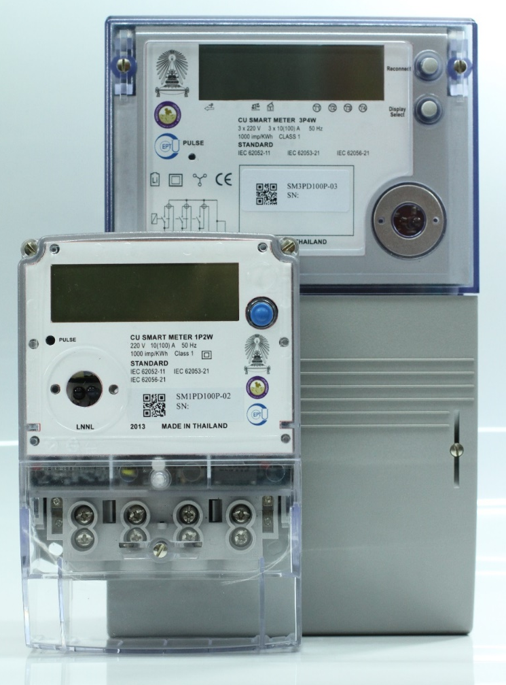
Smart Appliances
Smart Meters, Smart Plugs, Smart Appliances or IoT devices are crucial for Smart Cities.

Slide 10
A sign language image enlarger
To enlarge image of sign language translator so that the hearing impaired can understand spoken words more easily.

Slide 11
Autonomous Car
Adding sensors & intelligence brings steps towards the self-control & self decision car.

Slide 12
Thank you
Any Questions?

